Slide 1
Basic Introduction to Deep Learning
Manish Gupta
Visiting Faculty at ISB
Senior Applied Scientist at Microsoft, India
Adjunct Faculty at IIIT-H
Credits: Stanford CS224D course, CS231N Stanford course, Geoffrey Hinton’s course, http://deeplearning.net/tutorial

Slide 2
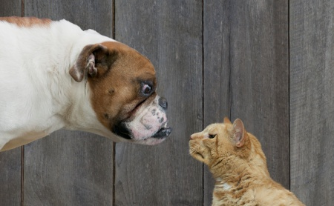

5 years ago: Computer vs. Human Brain
Best Accuracy Reported in Literature: 80%
Best Word Error Rate Achieved: 14%
Cats vs. Dogs
ASIRRA CAPTCHA Task
Track 2
5K Vocabulary from WSJ
Vision
Speech
The modern computer is still far off from some of the basic capabilities of a human brain!

Slide 3
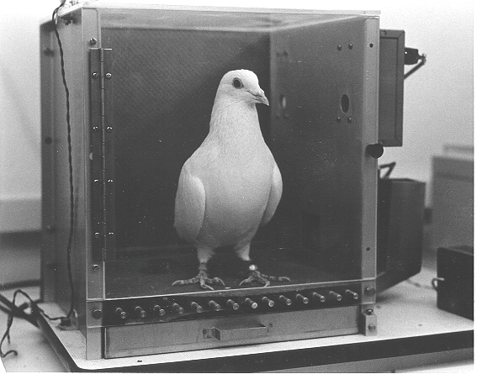
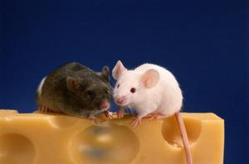
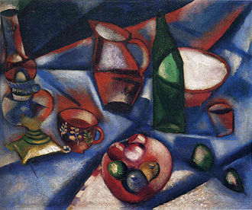
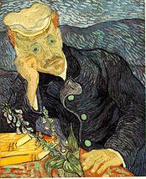
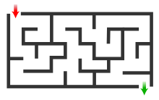
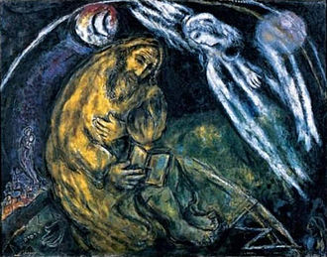
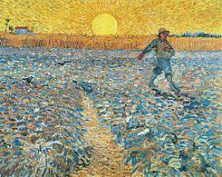
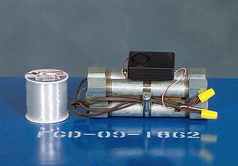
Thinking is possible even with a “small” brain
Pigeons as art experts – 85% (Watanabe et al. 1995)
Source: https://en.wikipedia.org/wiki/Marc_Chagall
https://en.wikipedia.org/wiki/Vincent_van_Gogh
Mice trained to run mazes[1], detect drugs[1][2]

Slide 4
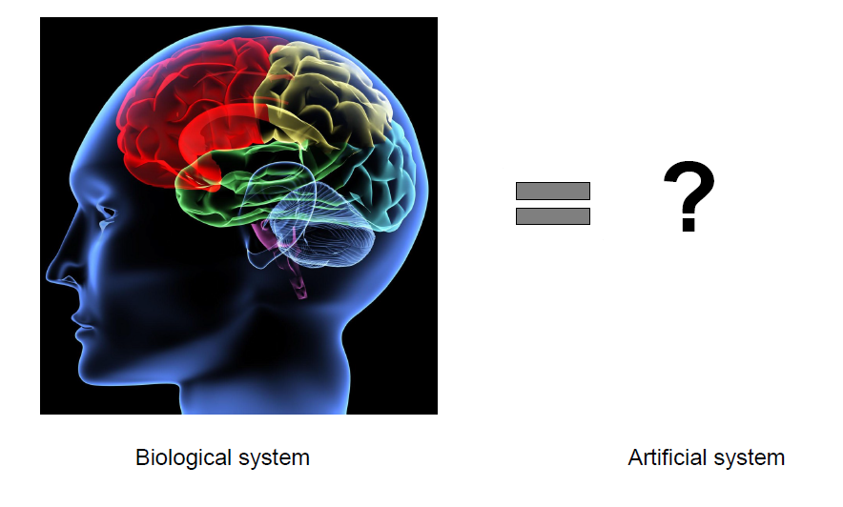
How can we mimic the human brain?

Slide 5
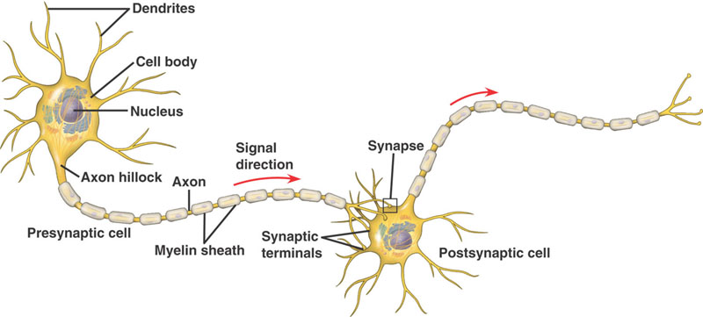
Neuron – Basic Unit of Information Processing
Excitatory
Or
Inhibitory
Will fire “action potential” when sum of input potentials exceeds a threshold

Slide 6
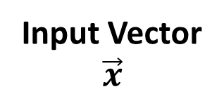
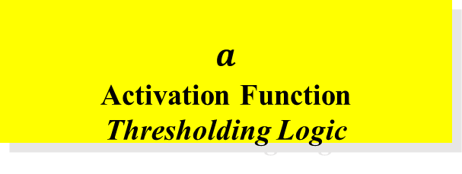
The Artificial Neuron
Proposed by McCulloch and Pitts [1943]
M-P neurons
x₁
w₁
x₂
∑
Output
Input Vector
$$\vec{x}$$
w₂
y
f (.)
a (.)
w_{m}
x_{m}
_{f}
_{Integration Function}
_{Aggregating} _{input signals}
$$a$$
_{Activation Function}
_{Thresholding Logic}

Slide 7
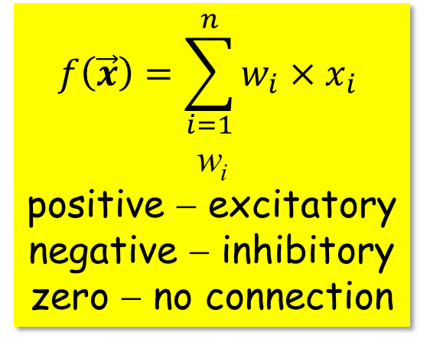
Integration Function ∑
∑
f (.)
a (.)
Responsible for aggregating input signals from other neurons
Controls boosting, inhibiting or completely suppressing the given input
Most common integration function
$$f\left(\vec{x}\right)=\sum_{i=1}^{n}{w_{i}×x_{i}}$$
w_{i}
positive − excitatory
negative − inhibitory
zero − no connection

Slide 8
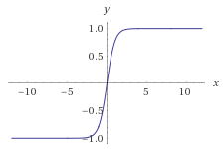
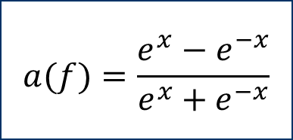
Activation Functions a (.)
∑
Flat curve (saturation) at tails.
Very small gradients in those regions
f (.)
a (.)
⎧
1
f
>
1
⎧
1
f
≥
0
⎪
$$a(f)=\frac{e^{x}−e^{−x}}{e^{x}+e^{−x}}$$
=
a
(
f
)
=
⎨
f
0
≤
f
≤
1
a
(
f
)
⎨
⎩
0
otherwise
⎪
<
⎩
0
f
0
a
a
1
1
f
1
f
Tanh
(Scaled sigmoid)
Step
Ramp
Sigmoid

Slide 9
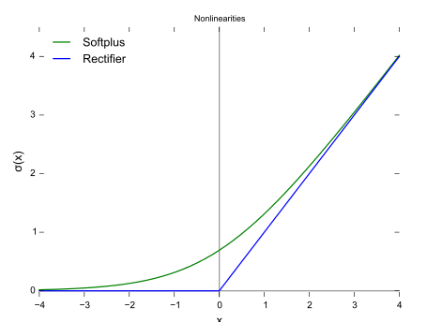
ReLU (Rectified Linear Units)
f(x)=max(0,x)
It increases the nonlinear properties of the decision function and of the overall network.
This is also known as a ramp function and is analogous to half-wave rectification in electrical engineering.
The rectifier is, as of 2018, the most popular activation function for deep neural networks.
A smooth approximation (softplus) to the rectifier is the analytic function: f(x)=log(1+exp(x)). Derivative of softplus is the logistic function.

Slide 10
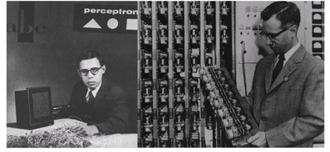
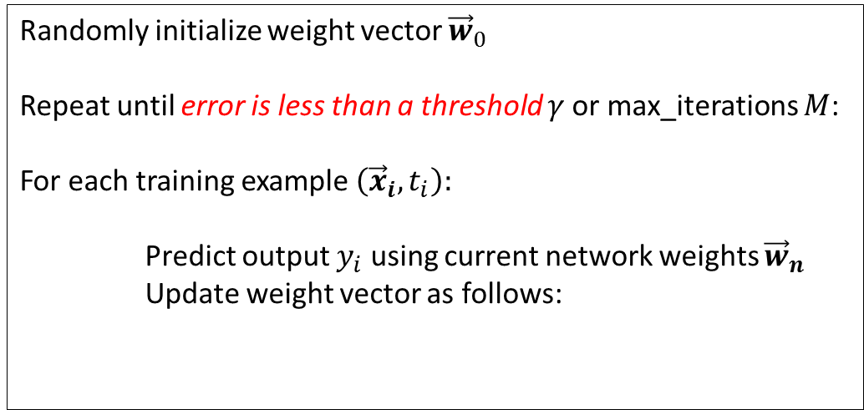
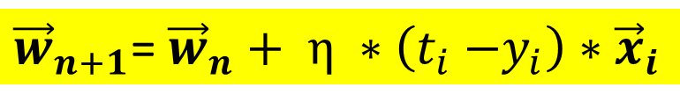
How to train a Perceptron?
Proposed by Rosenblatt [1962]
Perceptron Algorithm - Iterative algorithm to learn the weight vector
Basic Idea
Update weights in proportion to the error contributed by inputs
Randomly initialize weight vector ${\vec{w}}_{0}$
Repeat until error is less than a threshold $γ$or max_iterations $M$:
For each training example $\left({\vec{x}}_{i}, t_{i}\right):$
Predict output $y_{i}$ using current network weights ${\vec{w}}_{n}$
Update weight vector as follows:
${\vec{w}}_{n+1}$= ${\vec{w}}_{n}+ η ∗\left(t_{i}{−y}_{i}\right)∗{\vec{x}}_{i}$
Learning Rate
Error

Slide 11
Perceptron Explained – Toy Example
4 points linearly separable
2
1.5
(1/2, 1)
1
(-1,1/2)
0.5
(1,1/2)
0
Z = 1
Z = 0
-0.5
(-1,-1)
-1
-1.5
-2
-2
-1.5
-1
-0.5
0
0.5
1
1.5
2

Slide 12
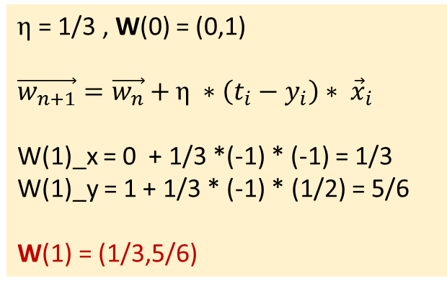
Perceptron Explained – Toy Example (Contd..)
$η$= 1/3 , W(0) = (0,1)
$\vec{w_{n+1}}=\vec{w_{n}}+η ∗\left(t_{i}−y_{i}\right)∗ {\vec{x}}_{i}$
W(1)_x = 0 + 1/3 *(-1) * (-1) = 1/3
W(1)_y = 1 + 1/3 * (-1) * (1/2) = 5/6
W(1) = (1/3,5/6)
Z = 1
Z = 0

Slide 13
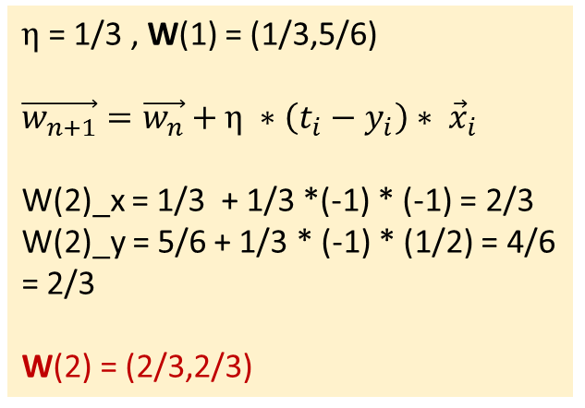
Perceptron Explained – Toy Example (Contd..)
first correction
2
1.5
W(1) = (1/3,5/6)
1
$η$= 1/3 , W(1) = (1/3,5/6)
$\vec{w_{n+1}}=\vec{w_{n}}+η ∗\left(t_{i}−y_{i}\right)∗ {\vec{x}}_{i}$
W(2)_x = 1/3 + 1/3 *(-1) * (-1) = 2/3
W(2)_y = 5/6 + 1/3 * (-1) * (1/2) = 4/6 = 2/3
W(2) = (2/3,2/3)
0.5
0
-0.5
-1
-1.5
-2
-2
-1.5
-1
-0.5
0
0.5
1
1.5
2

Slide 14
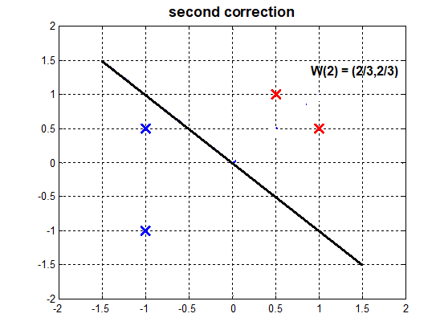
Perceptron Explained – Toy Example (Contd..)
Correction of weights turned out to be a
rotation of the separating hyper plane

Slide 15
What can be achieved by single Perceptron?
Minsky et. al. proved single M-P neuron is no better than a linear classifier [1969]
x₁
w₁
x₂
∑
y
w₂
0
x₂
f (.)
a (.)
w_{m}
w₁ x₁ + w₂ x₂ =θ
x_{m}
1
θ
x₁
1
Bias Term

Slide 16
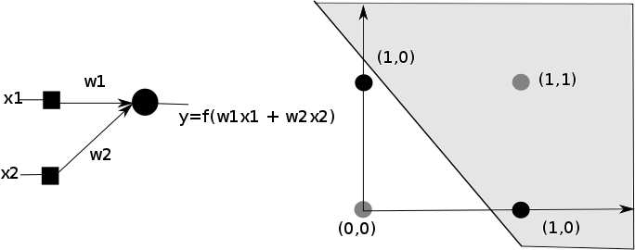
Will it work here?
x1 | x2 | y
0 | 0 | 0
1 | 0 | 1
0 | 1 | 1
1 | 1 | 0
A line representing the function of a single perceptron
Perceptron outputs a positive value for region above the line
Negative vaue for region below the line
Notes:
16

Slide 17
Learning Non-Linear Patterns
Non-Linear Patterns
Change Integration Function
Multi-Layered Perceptrons

Slide 18
Changing Integration Functions
Very similar to the Kernel Trick in SVMs!
∑
f (.)
a (.)
Quadratic Function
What integration functions can we have?
Spherical Function

Slide 19
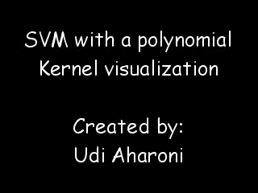
Polynomial Kernel Visualization

Slide 20
Multi-Layered Perceptrons (MLPs)
y₁
y₂
y_{n}
. . .
Output Layer
. . .
Hidden Layer
. . .
. . .
Input Layer
x₁
x₂
x_{m}

Slide 21
What kind of Decision Boundaries do MLPs learn?
y
L₁
x−1=0
L₃
−x−y+4=0
θ₁=1
θ₂=1
θ₃= −4
L₁
L₂
L₃
L₂
0
−1
1
1
−1
y−1=0
0
x
x
y

Slide 22
Layer-wise Activation Regions
010
y
L₁
Region Code
L₃
011
L₁
L₂
L₃
110
111
L₂
001
101
100
x
x
y

Slide 23
Capturing Non-Linearity through Layer Addition
y
z
L₁
z=0
θ₄=2.5
L₄
L₃
1
1
1
L₁
L₂
L₃
z=1
L₂
x
x
y

Slide 24

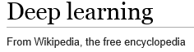
What is deep learning?
Deep learning (deep machine learning, or deep structured learning, or hierarchical learning, or sometimes DL) is a branch of machine learning based on a set of algorithms that attempt to model high-level abstractions in data by using model architectures, with complex structures or otherwise, composed of multiple non-linear transformations.^{[1](p198)[2][3][4]}

Slide 25

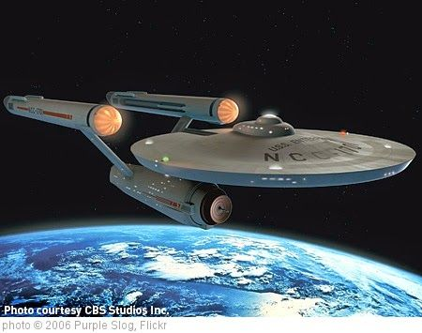
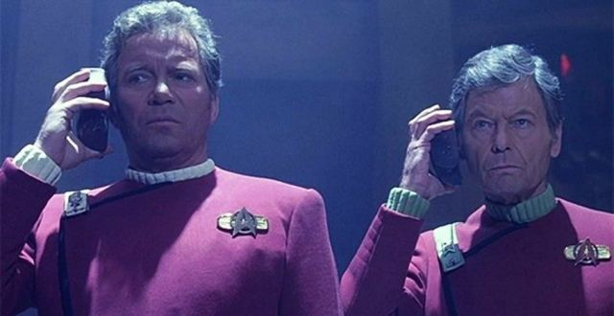


The Universal
Translator …
comes true!
Scientists See Promise in Deep-Learning Programs
John Markoff
November 23, 2012
Tianjin, China, October, 25, 2012
Deep learning
technology enabled
speech-to-speech
translation
A voice recognition program translated a speech given by
Richard F. Rashid, Microsoft’s top scientist, into Mandarin Chinese.

Slide 26

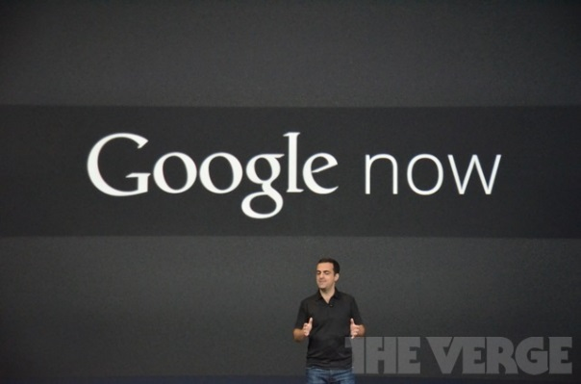





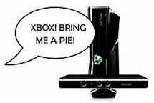
Across-the-Board Deployment of DNN in Speech Industry
(+ university labs & DARPA programs)

Slide 27
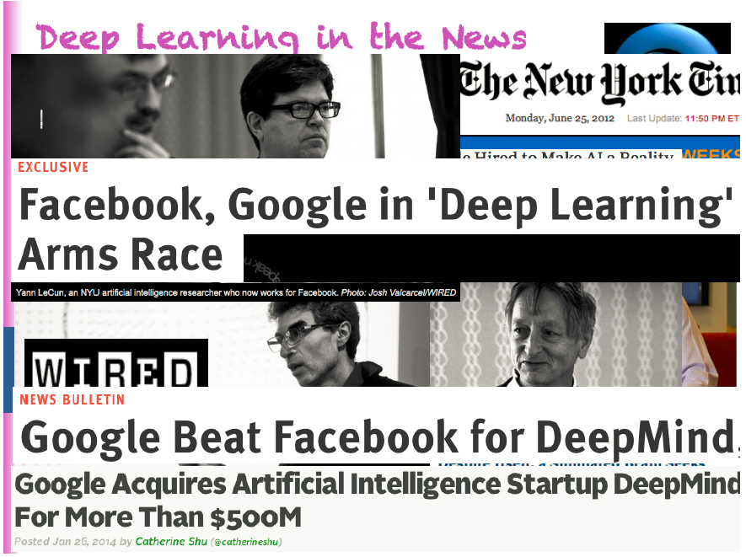
(Slide from Bengio, 2015)

Slide 28
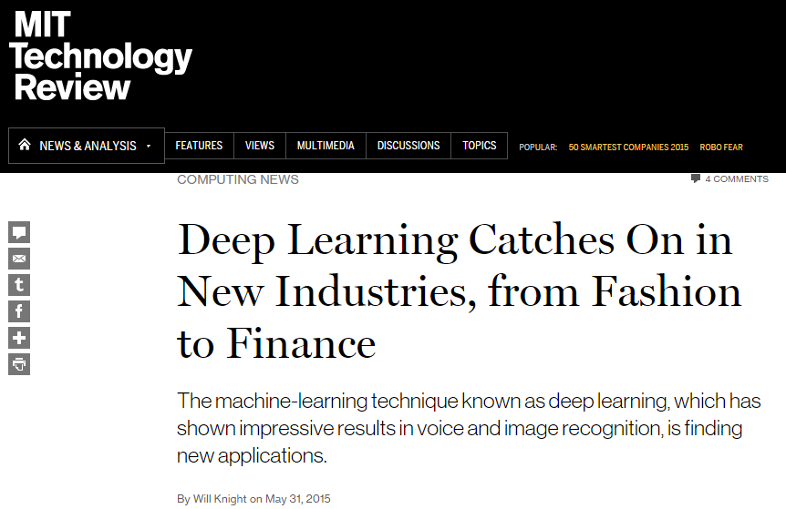
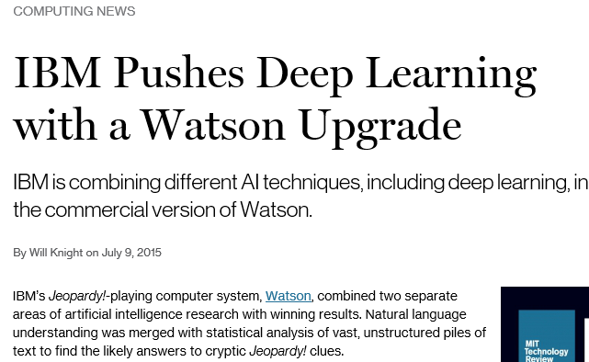
More Recent Media Hype

Slide 29
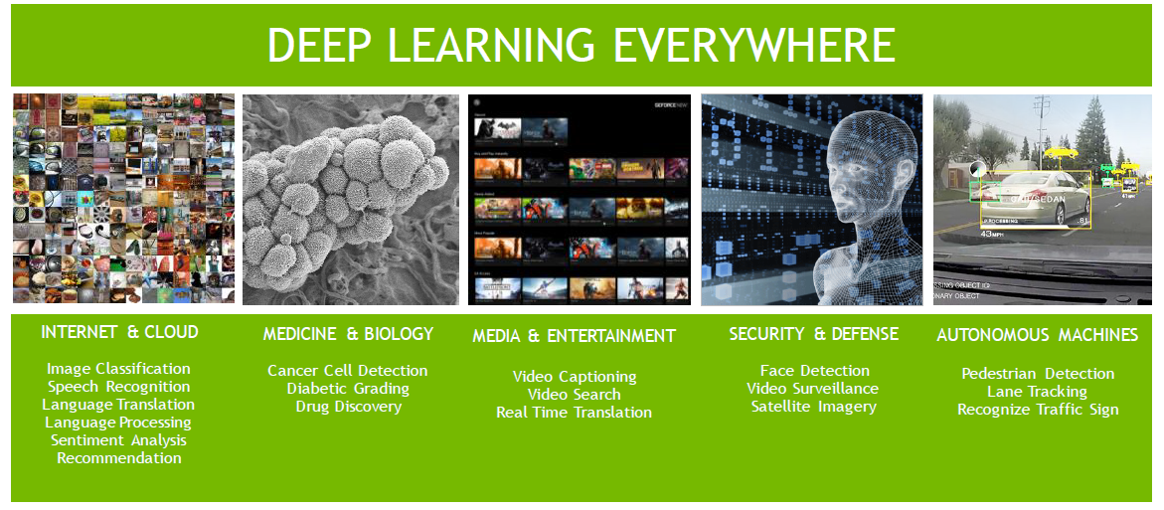
Deep learning is everywhere

Slide 30
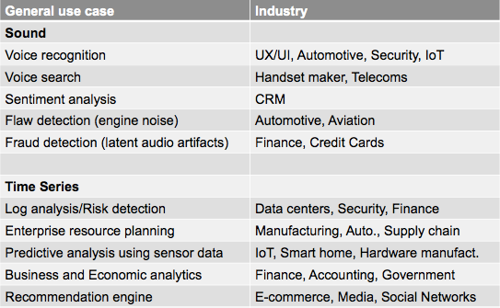
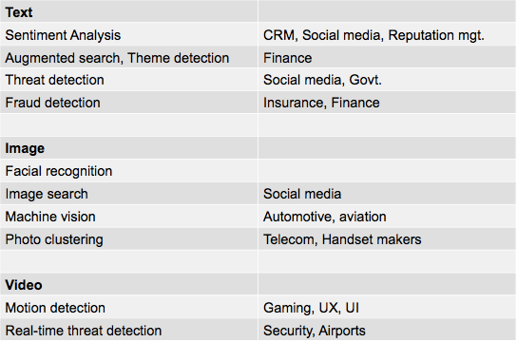
Deep Learning Use Cases

Slide 31
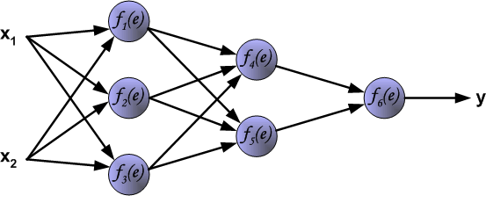
The Back Propagation Algorithm
f (.)
a (.)
For ease of explanation, assume the change of notation
The resultant MLP
f (.)

Slide 32
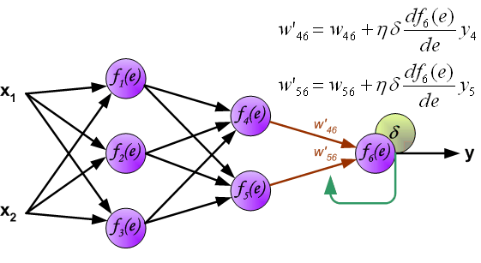
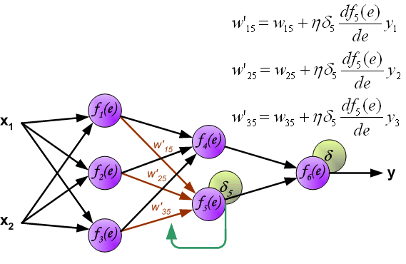
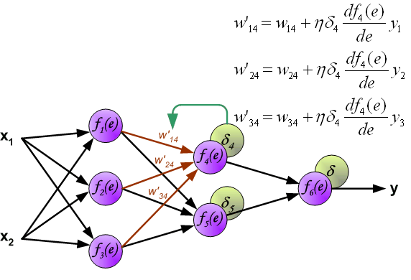
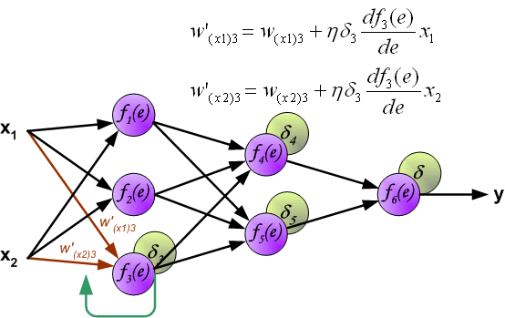
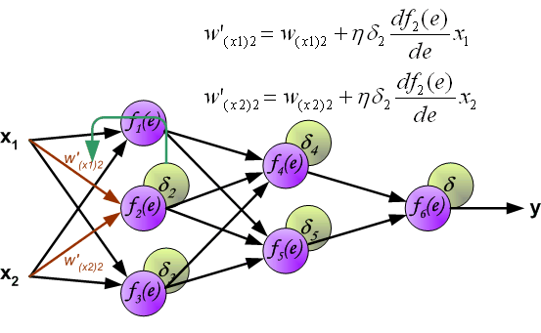
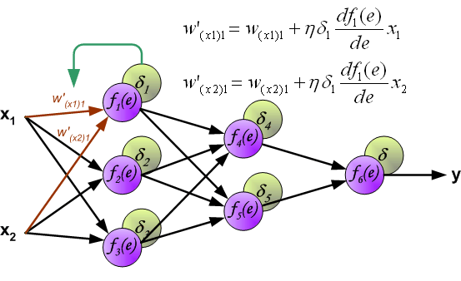
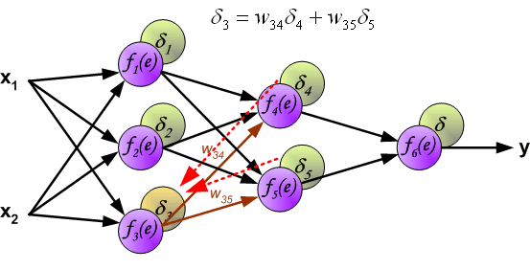
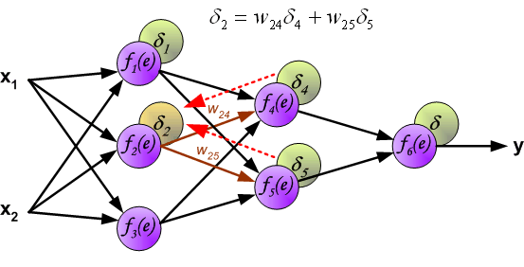
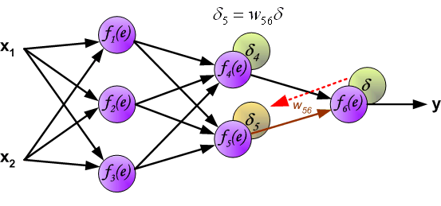
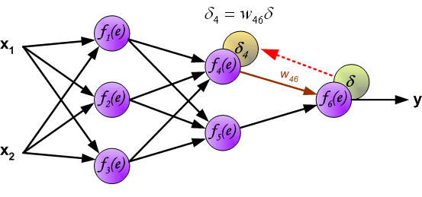
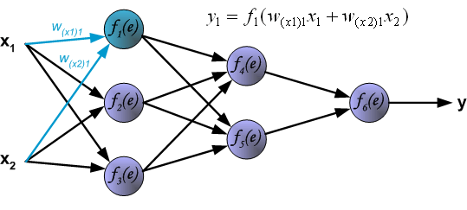
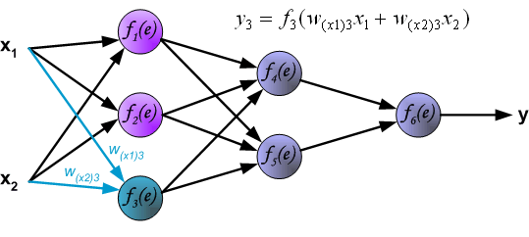
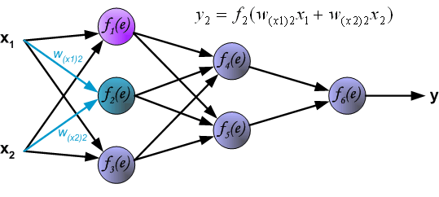




Back Propagation Demo

Slide 33




Error surface
Cost as a function of weights
Error($w_{1},w_{2}$)
Error
$$w_{2}$$
$$w_{1}$$

Slide 34






Moving down the hill
Error
Error
$$w_{2}$$
$$w_{2}$$
$$w_{1}$$
$$w_{1}$$

Slide 35

Local minima issues in gradient descent learning
Error
$$w_{2}$$
Error
$$w_{1}$$
$$w_{2}$$
$$w_{1}$$

Slide 36
Why worry about ANNs when I have SVM?

Slide 37
Why worry about ANNs when I have SVM? (Contd..)
Fundamental difference
ANNs can learn both representation + weights
One of the major limiting factors in computer vision
In case of SVMs, feature engineering required
Needs expert knowledge, time-consuming, hand-tuning required

Slide 38
Representation Learning in Vision

Slide 39

Practical Advice on Applying NNs
Start with one input, one hidden and one output layer
Theoretically can represent any function using the above
Add additional layers only if above doesn’t work well
Weights should be initialized to random, small and non-zero values
Learning rate influences the learning process a lot
Big values cause huge jumps
Smaller values cause long convergence times
Variable rates usually employed
Practically good ranges: $0.01≤ η ≤0.9$

Slide 40
Practical Advice on Applying NNs (Contd..)
If we train for too long, possible overfitting – the test error increases
Use validation error to check overfitting
Simpler models are better – try them first (Occam’s Razor)

Slide 41

Deep Learning Libraries

Slide 42
Summary
Artificial Neural Network (ANN) is a computational model inspired from the workings of the human brain
Although a perceptron can simply represent linear functions, multiple layers of perceptrons can represent arbitrary complex functions
The various parameters of a feed forward ANN such as learning rate, number of hidden layers, initial weight vectors need to be carefully chosen
An ANN allows learning of deep feature representations from the original training data

